Slide 1

CUSTOMER BEHAVIOUR ANALYSIS OF AN E-COMMERCE GIANT
CONTENTS :-
Database Source
Aspects Taken Into Consideration
Power BI Visualisation
Information Extracted & Suggestions

Slide 2
Database Source :-
https://www.kaggle.com/datasets/shriyashjagtap/e-commerce-customer-for-behavior-analysis/
Aspects Taken Into Consideration :-
Customer Demographics
Month-Wise Total Purchase of Different Product Categories
Purchasing Pattern in Different Time Periods of Different Products Categories
Category-Wise Overall Rating
Gender & Age Wise Rating of Clothing Products
Gender & Age Wise Return Percentage of Different Product Categories
Gender & Age Wise Purchase Share of Different Product Categories
Inventory Management
Gender & Age Wise Sales Trend and Prediction of Clothing Products

Slide 3
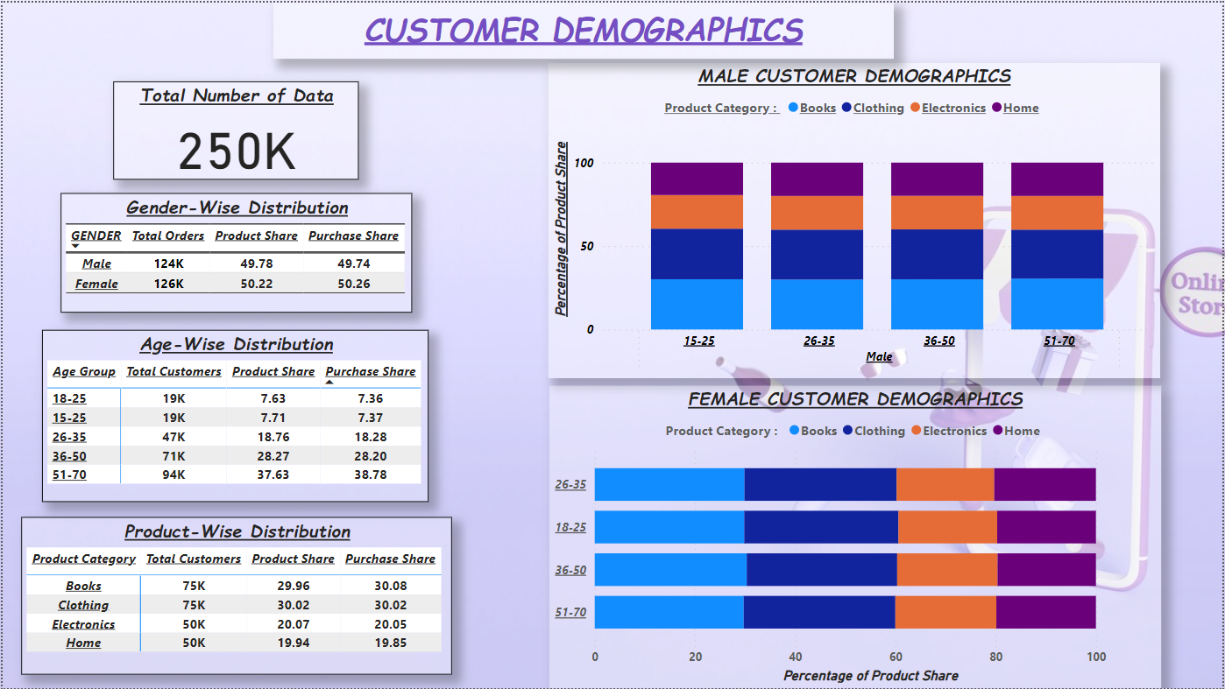
Power BI Visualisation

Slide 4
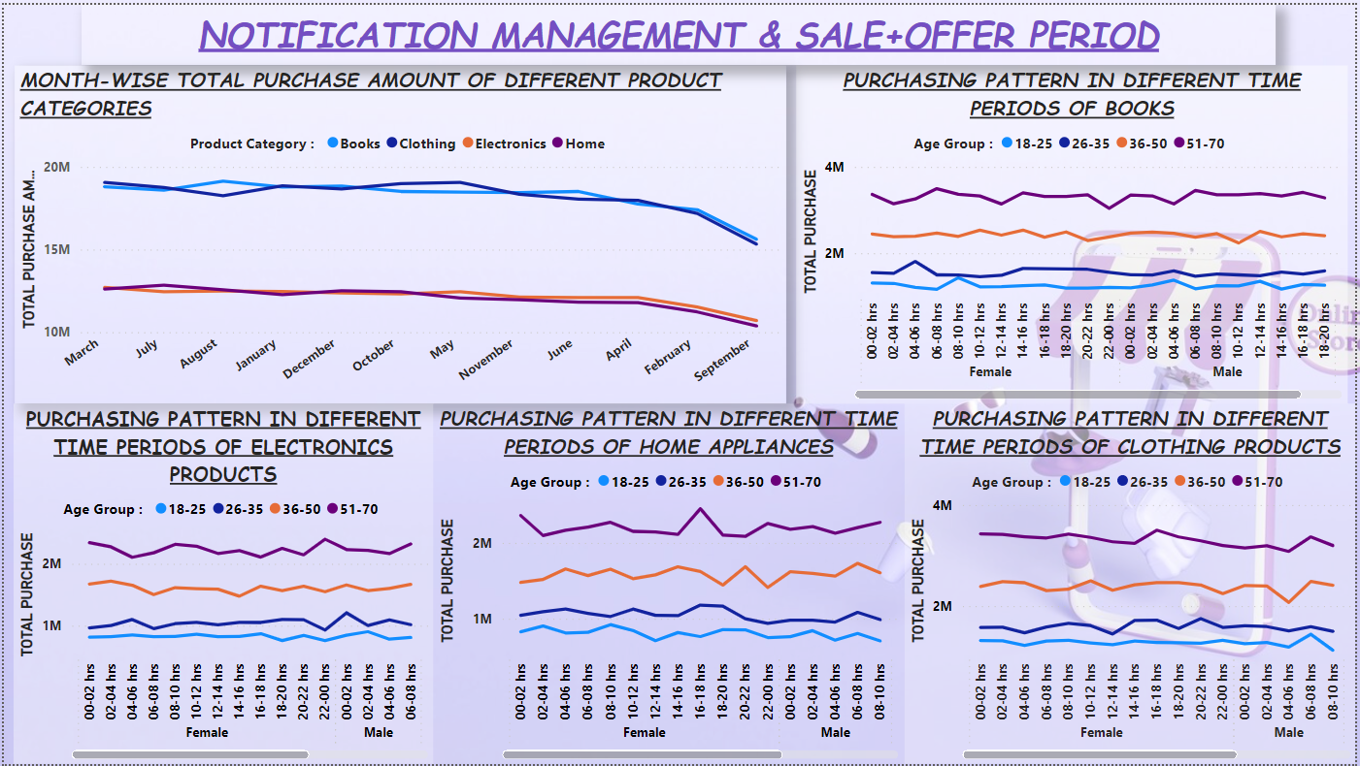

Slide 5
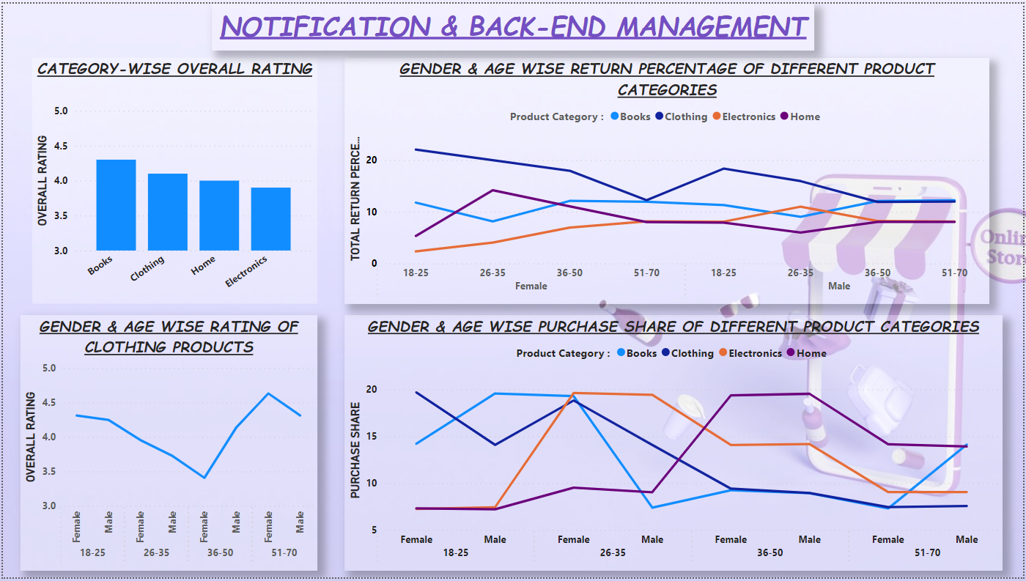

Slide 6
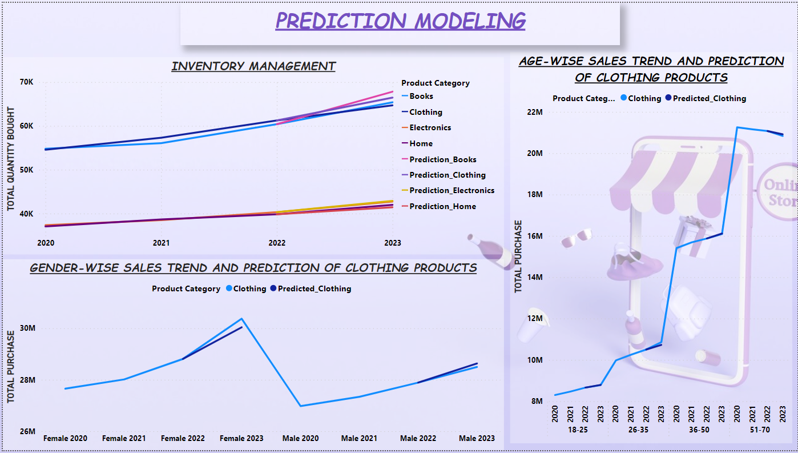

Slide 7
Information Extracted & Suggestions
Least purchase months : February & September
Suggestions : Special Offers and Big Deals should be introduced in these months to ensure more and more purchases and improve engagements.
Peak Purchase Periods (in hrs) :-
Suggestions : Notifications can be managed accordingly. For eg. If the customer is male and have age in the range of 26-35 , notifications related to books should pop up in between 14-16 hrs to attract more and more customers.
 | MALE |  |  |  | FEMALE
AGE → | 18-25 | 26-35 | 36-50 | 51-70 | 18-25 | 26-35 | 36-50 | 51-70
Books | 04-06 | 14-16 | 12-14 | 06-08 | 08-10 | 04-06 | 14-16 | 06-08
Clothing | 06-08 | 06-08 | 16-18 | 16-18 | 00-02 | 20-22 | 10-12 | 16-18
Electronics | 02-04 | 00-02 | 18-20 | 16-18 | 16-18 | 04-06 | 20-22 | 22-00
Home | 22-00 | 12-14 | 06-08 | 18-20 | 08-10 | 16-18 | 20-22 | 16-18

Slide 8
Overall Rating :-
Books - 4.3/5 ; Clothing : 4.1/5 ; Home : 4/5 ; Electronics : 3.9/5
Suggestions :-
Product categories like books, clothing and home appliances requires less focus but
constant attention to maintain the same.
Whereas Electronic Products needs to be tracked with focus at every stage as well as to
receive best products from retailers.
Customers leading to least rating of Clothing Products :-
Male (26-35) and Female (36-50)
Suggestions :-
Generally clothing products are ordered by the different sex and age groups for their
own needs and matching their sizes.
So clothing products related to Male and age group 26-35 & Female and age group
36-50 needs extra attention to boost products ratings.
Customers leading to most returns :-
Books – 36-50 (Female) , 51-70 (Male)
Clothing – 18-25 (Both Male and Female)
Electronics – 26-35 (Male)
Home Appliances – 26-35 (Female)
Suggestions :-
Addition to improve customer ratings, one’s target is to reduce returns. So the company should analyse the reasons for returns of such products among above mentioned sex and age groups and work on them to minimise the number of returns.

Slide 9
Highest and Lowest Purchase Share of Different Product Categories :-
Books – (H) : Male (18-25) ; (L) : Female (51-70)
Clothing – (H) : Female (18-25); (L) : Male (51-70)
Electronics – (H) : 26-35 ; (L) : 51-70
Home – (H) : 36-50 ; (L) : 18-25
Suggestions :-
Keeping in mind the above data as well as customer demographics and peak purchase hours, the notifications can be managed in effective way.
For eg. : Male + 18-25 → Notifications of different product categories can be pushed in respective peak hours ; New customers’ home page can be regulated as per customer demographics ; High offers and deals can be regulated as per highest and lowest purchase share of different product categories.
Prediction Modelling - 2023 :-
INVENTORY MANAGEMENT :-
 | Quantity Bought (Actual) | Quantity Bought (Predicted) | Error (%)
Books | 65378 | 67808 | 3.72
Clothing | 64700 | 66463 | 2.73
Electronics | 42731 | 42894 | 0.38
Home | 41984 | 41415 | 1.36
Average Prediction Error for 2023 → |  |  | 2.048

Slide 10
GENDER-WISE PREDICTION OF CLOTHING PRODUCTS :-
AGE-WISE PREDICTION OF CLOTHING PRODUCTS :-
 | Total Purchase (Actual) | Total Purchase (Predicted) | Error (%)
Male | 28498280 | 28920055 | 1.48
Female | 30372107 | 31310605 | 3.09
Average Prediction Error for 2023 → |  |  | 2.29 %
 | Total Purchase (Actual) | Total Purchase (Predicted) | Error (%)
18-25 | 9779922 | 9522710 | 2.63
26-35 | 13858299 | 13191715 | 4.81
36-50 | 16090121 | 16308947 | 1.36
51-70 | 20834209 | 21613408 | 3.74
Average Prediction Error for 2023 → |  |  | 3.14

Slide 11
THANK YOU !

